Slide 1
CAPSTONE PROPJECT: MARKETING AND RETAIL ANALYTICS
Presented by:-
Neha patil
Rishikesh Gundla
Gagan sharma

Slide 2
Problem definition
OList is one such e-commerce company that has faced some losses recently and they want to manage their inventory very well so as to reduce any unnecessary costs that they might be bearing.
Need to identify top products that contribute to the revenue and also use market basket analysis to analyze the purchase behavior of individual customers to estimate with relative certainty, what items are more likely to be purchased individually or in combination with some other products.
So ultimately, we need to help OList to identify the product categories which they can get rid of without significantly impacting business

Slide 3
Project pipeline
Data exploration and cleaning: Identify missing and duplicate values in each column and treat them accordingly. Also, treat any and all data quality issues associated with the dataset.
Data visualization: Create appropriate visualizations to identify the most ordered products by quantity and revenue.
Market basket analysis: Identify combinations of product categories that are ordered frequently and visualize them as required. This can be done by creating a simple matrix with product categories in the rows and columns and then checking which of the pairs show associations.
Dashboarding and final PPT: Create a neat dashboard containing the important visualizations and supplement it with an executive summary containing valuable insights and recommended steps of action..

Slide 4
data exploration and cleaning
Exploratory Data Analysis:-
Imported all the CSV files of Retail dataset into JupyertLab.
We used pandas library to load and clean the dataset.
Performed data exploration on all the CSV files to understand the data quality issues.
Performed cleaning process on all the CSV files such as removing null values, duplicates records and outliers if present.
As instructed, we only considered records having order status as ’delivered’.
After cleaning all data frame we exported it back into CSV files.

Slide 5
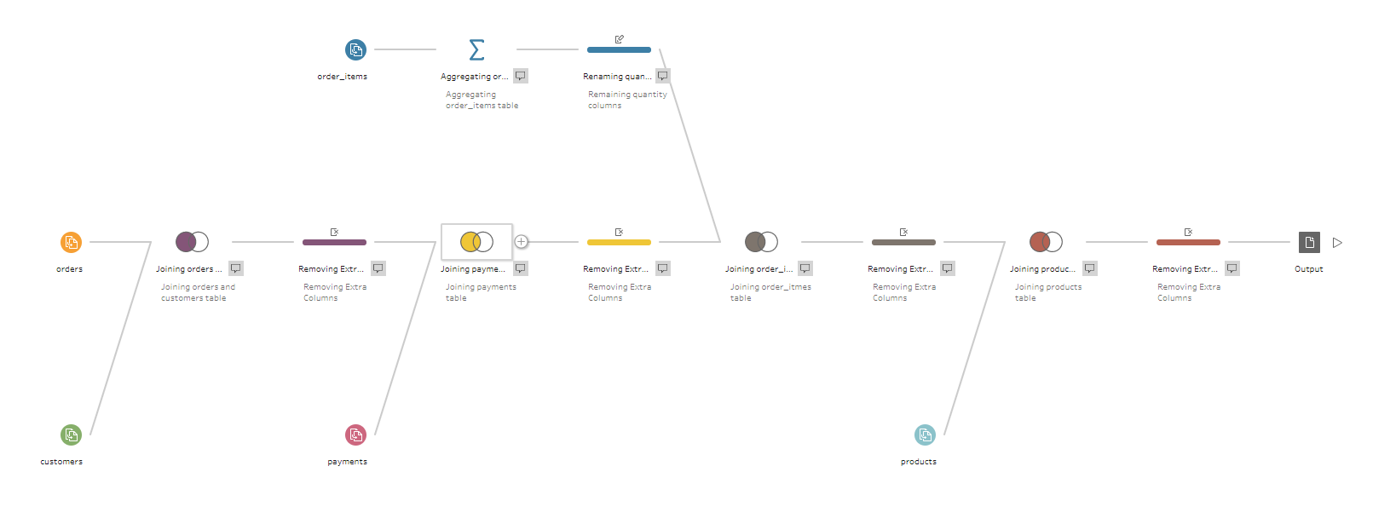
data exploration and cleaning
ETL Pipeline:-
In the ETL Pipeline, we have used Tableau Prep to join all the cleaned CSV files and transformed the data into proper format and then outputted it into an single CSV file.

Slide 6
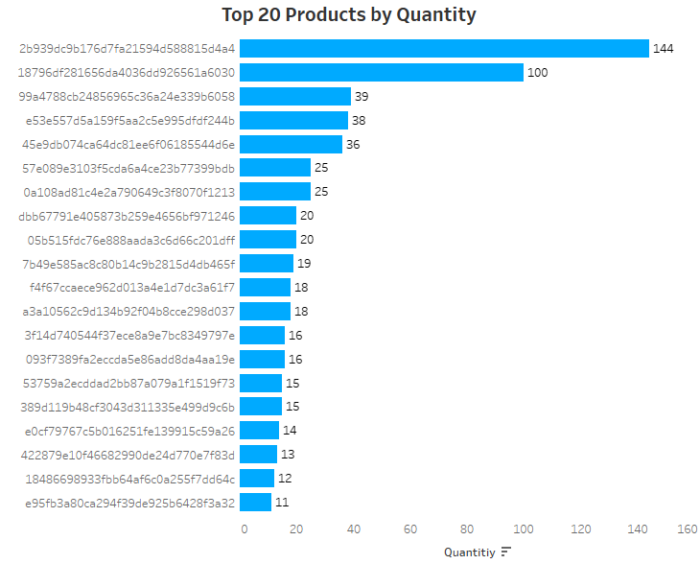
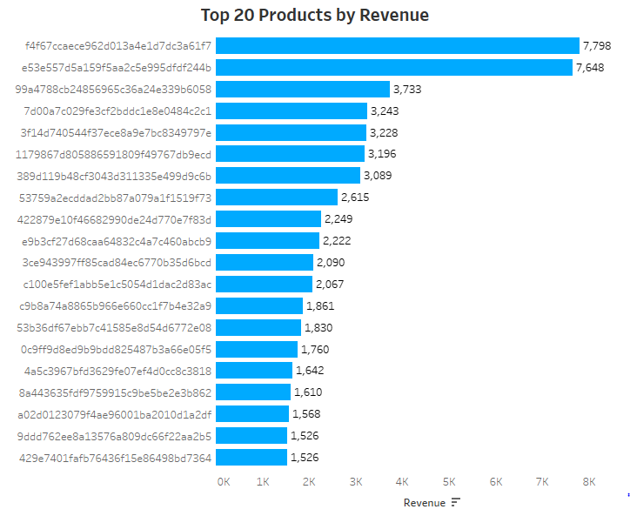
Data visualization
This bar graph shows Top 20 products sold by quantity
This bar graph shows Top 20 products sold by revenue

Slide 7
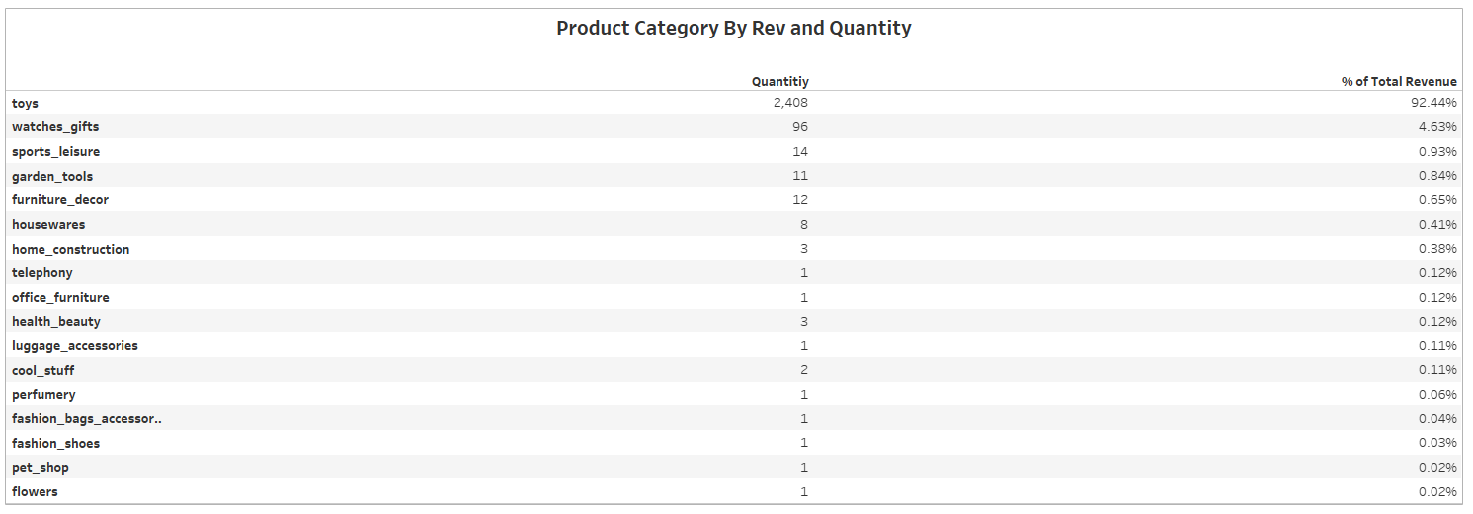
Data visualization
Toys category contributes to 92% of the total revenue with around 2400 quantity of product sold.

Slide 8
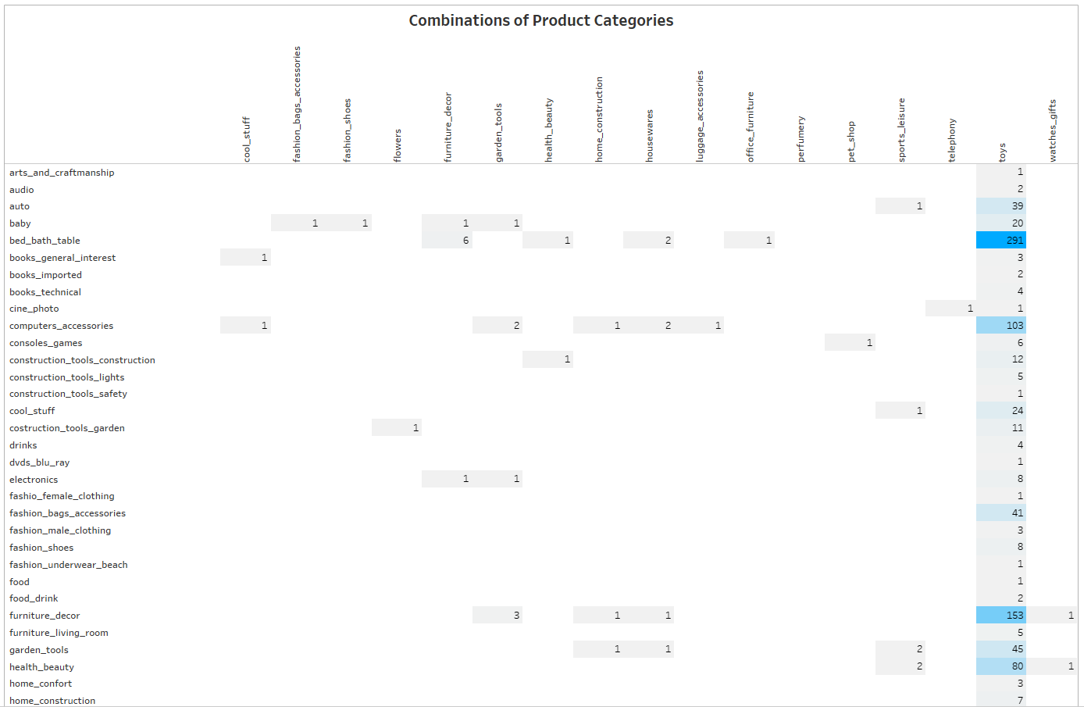
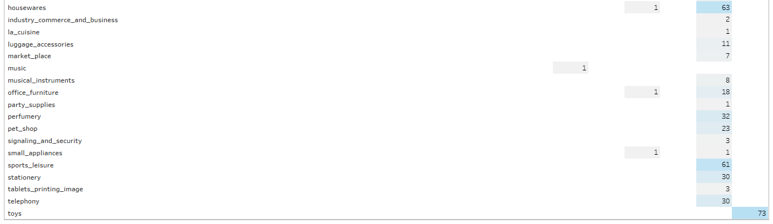
MARKET BASKET analysis
This heat map show Market Basket Analysis for all combination of Product Categories.
We can see here toys product are mostly sold with the rest of the product category.
Toys are mostly sold with bed bath table, furniture décor and computer décor.

Slide 9
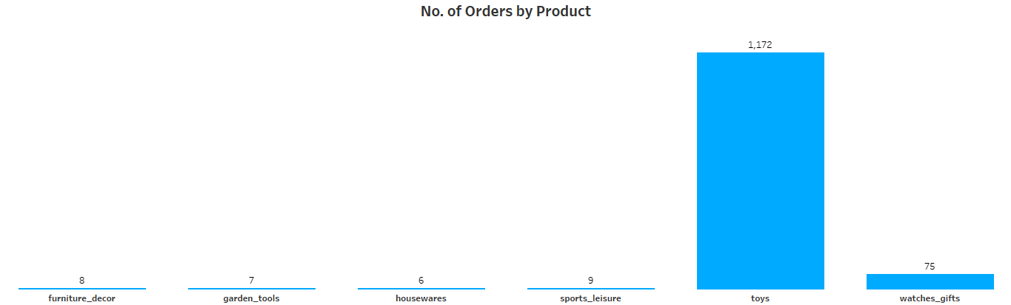
MARKET BASKET analysis
This bar graph represents all the Product Categories which are at least ordered more than 5 times

Slide 10
insights
The category “Toy” contributes to 92% of the total revenue with around 2400 quantity of product sold.
Top 20 products by Quantity and Revenue are all of Toys category.
It can be seen that even if the price of the certain products is high, it is still bought by the customer more often.
The category apart from Toys which are ordered more than 5 times are furniture décor, watches gifts, garden tool, houseware and sports leisure.
Using Market Basket Analysis, Toys category products is the most sold among the rest of the product category.
Hence, Toys with the combination of bed bath table, furniture décor and computer décor and each other are frequently ordered by customers.

Slide 11
recommendations
Company should focus on giving offers for customer who are frequently purchasing to retain them.
Since there are many category of product which are very rarely sold they should discontinue them, so that they could focus more on best selling products and traffic will easily shift to those products.
Target customer which are more likely to buy toys for eg:- Parents of new born baby, Birthday gits for children etc
Put some catchy discount or offers on best selling combination of products.
Perform online marketing on social media of best selling products categories to target children of right age group.

